Slide 1

WEB Development
Grade 7&8

Slide 2

Introduction to HTML and CSS

Slide 3

How Sarah Became Famous
Sara wants to tell her stories to everyone, but she doesn't know how. Then she hears that she can make a webpage to do it. But she doesn't know how to make one.
As Sarah thinks about her problem, she asks herself: How can she learn to make a webpage and share her stories with the world?
Notes:
The answer is simple: Sara can start by learning basic HTML, the language used to create webpages. With practice and dedication, she can gradually build her webpage and share her stories with the world.

Slide 4
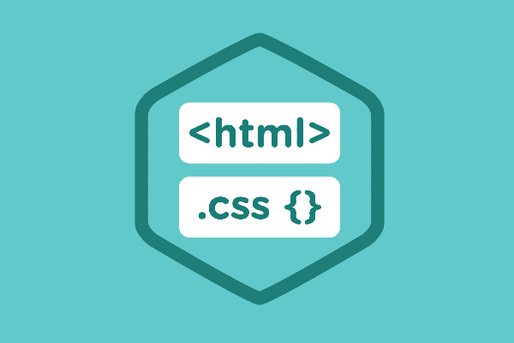
What is a webpage?
A webpage is a document on the World Wide Web that is identified by a unique URL.
It is displayed in a web browser and typically contains text, images, videos, and links to other webpages.
Notes:
Instructions for the Teacher:
Show students examples of different types of webpages using the provided links (YouTube, Wikipedia, Amazon).
Demonstrate how to inspect element on a webpage to understand its structure.
Class Activity:
Engage students by asking them to explore a webpage of their choice and identify different elements using inspect element.
Challenge them to modify the webpage's content (e.g., changing the text) using HTML and CSS.

Slide 5

Examples of Webpages:
Homepages: The main page of a website,
e.g., https://www.google.com/
Blogs: Articles or posts on various topics,
e.g., https://medium.com/
E-commerce Pages: Online shopping sites,
e.g., https://www.amazon.com/
Social Media Pages: Feeds on social platforms, e.g., https://www.facebook.com/
Notes:
Instructions for the Teacher:
Show students examples of different types of webpages using the provided links (YouTube, Wikipedia, Amazon).
Demonstrate how to inspect element on a webpage to understand its structure.
Class Activity:
Engage students by asking them to explore a webpage of their choice and identify different elements using inspect element.
Challenge them to modify the webpage's content (e.g., changing the text) using HTML and CSS.

Slide 6
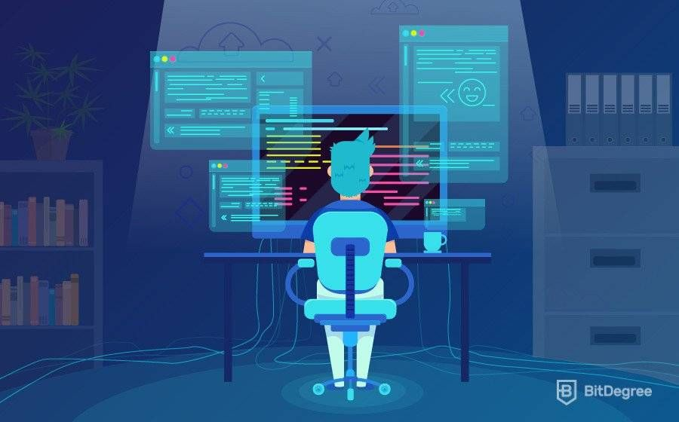
Inspect Element Activity
The "Inspect Element" feature in web browsers allows users to view and modify the HTML and CSS of a webpage in real-time. This is useful for web developers and anyone interested in learning how webpages are structured.
Notes:
Instructions for the Teacher:
Show students examples of different types of webpages using the provided links (YouTube, Wikipedia, Amazon).
Demonstrate how to inspect element on a webpage to understand its structure.
Class Activity:
Engage students by asking them to explore a webpage of their choice and identify different elements using inspect element.
Challenge them to modify the webpage's content (e.g., changing the text) using HTML and CSS.

Slide 7
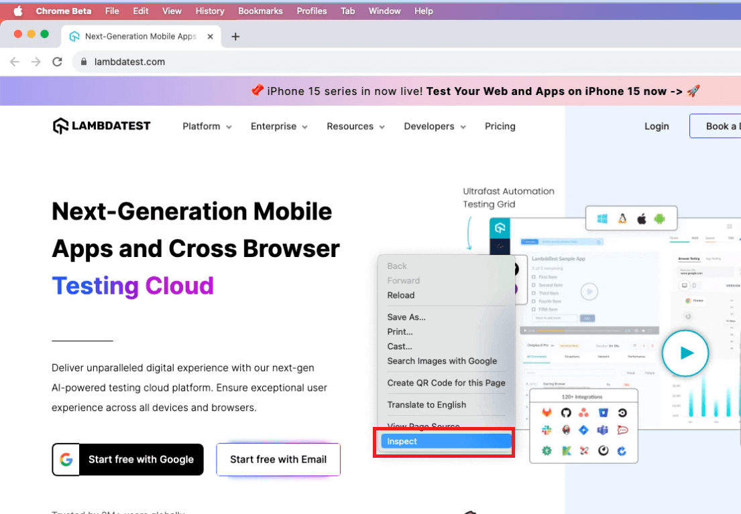
Inspect Element Activity
Notes:
Instructions for the Teacher:
Show students examples of different types of webpages using the provided links (YouTube, Wikipedia, Amazon).
Demonstrate how to inspect element on a webpage to understand its structure.
Class Activity:
Engage students by asking them to explore a webpage of their choice and identify different elements using inspect element.
Challenge them to modify the webpage's content (e.g., changing the text) using HTML and CSS.

Slide 8
Steps to Use Inspect Element
Open the Browser: Launch your web browser (Chrome, Firefox, Edge, etc.)
Navigate to a Webpage: Go to the webpage you want to inspect.
Right-Click on the Page: Right-click on any element on the webpage.
Select "Inspect" or "Inspect Element": This will open the browser's developer tools.
View and Edit HTML/CSS: In the developer tools pane, you can see the HTML code and CSS styles. You can make temporary changes to see how they affect the webpage.
Notes:
Instructions for the Teacher:
Show students examples of different types of webpages using the provided links (YouTube, Wikipedia, Amazon).
Demonstrate how to inspect element on a webpage to understand its structure.
Class Activity:
Engage students by asking them to explore a webpage of their choice and identify different elements using inspect element.
Challenge them to modify the webpage's content (e.g., changing the text) using HTML and CSS.

Slide 9
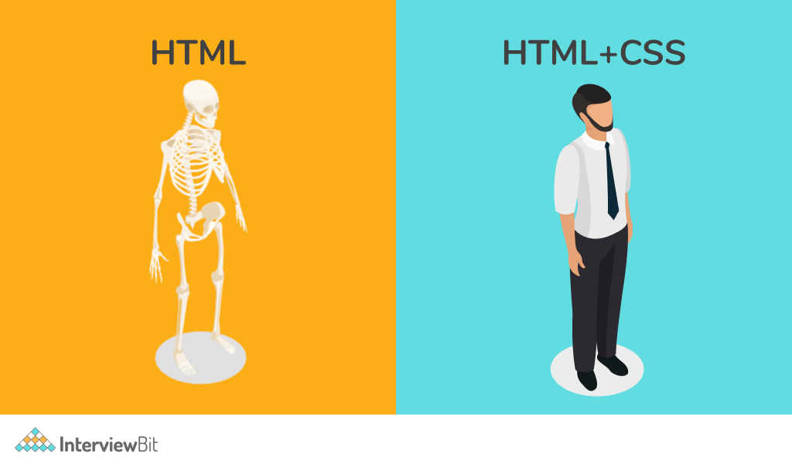
Exploration Begins Here
HTML, or Hypertext Markup Language, is like the skeleton of a webpage.
Just as a human skeleton provides structure and support for the body, HTML provides the framework for organizing content on a webpage.
CSS, or Cascading Style Sheets, is like the clothing and appearance of a person. CSS adds style, color, and layout to make the webpage visually appealing.
Notes:
Instructions for the Teacher:
Explain the analogy of HTML being the skeleton and CSS being the interior design of a webpage.
Emphasize the importance of both HTML and CSS in creating visually appealing and functional websites.
Class Activity:
Have them identify the HTML structure and CSS styles used on the webpage.
Encourage discussion on how the webpage could be improved or redesigned.

Slide 10

How to Create Account on Replit
Replit is an online integrated development environment (IDE) that allows you to write, run, and collaborate on code in various programming languages, including HTML and CSS
To get started:
Visit "replit.com"
Click on "Start Building" from top right corner. (Log-in if you already have an account)
You can use "email" or continue with "Google"
Notes:
Instructions for the Teacher:
Guide students through the process of creating an account on Replit.
Demonstrate how to access the HTML and CSS editor on Replit.
Class Activity:
Have students follow along as you create an account on Replit.
Encourage them to explore the features of Replit and familiarize themselves with the HTML and CSS editor.

Slide 11
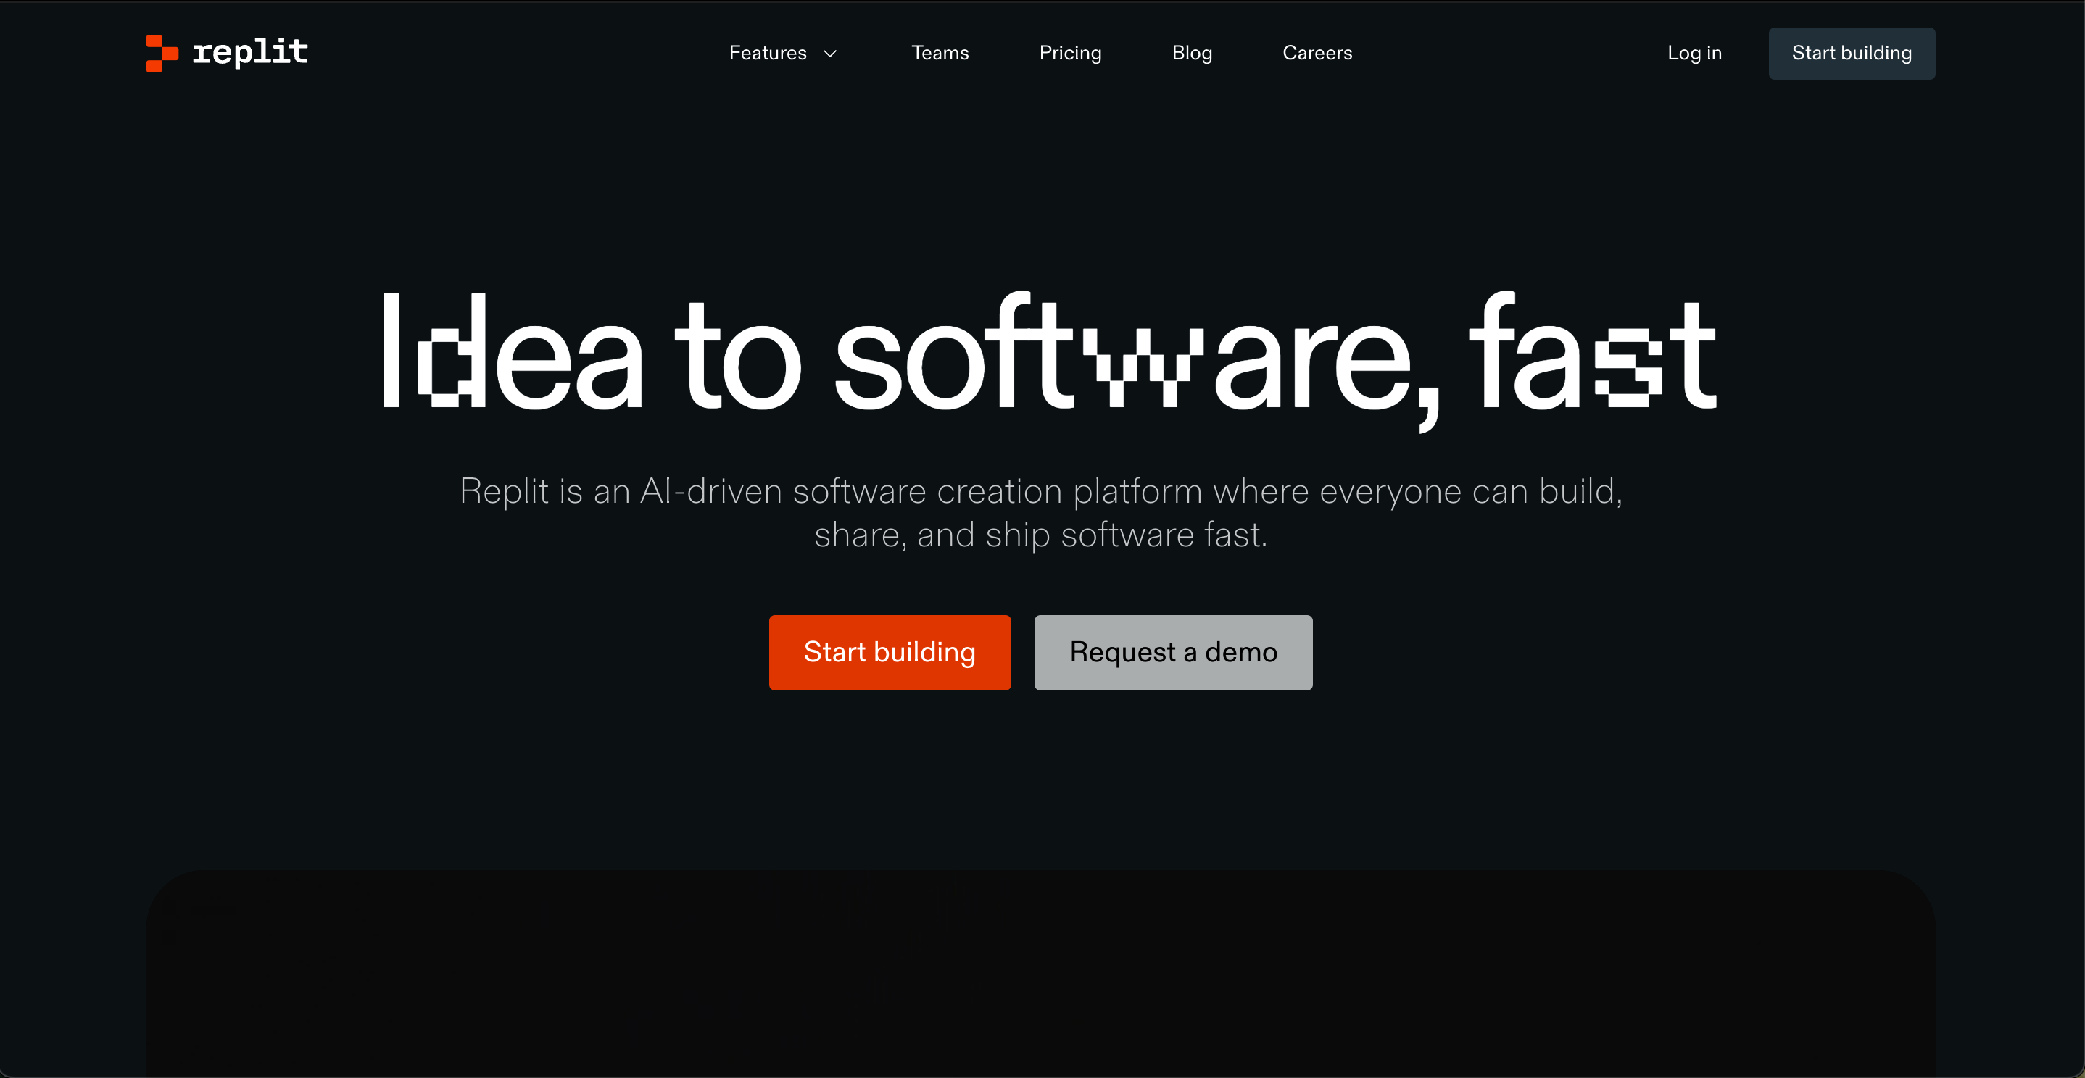
REPLIT.COM
Notes:
Instructions for the Teacher:
Guide students through the process of creating an account on Replit.
Demonstrate how to access the HTML and CSS editor on Replit.
Class Activity:
Have students follow along as you create an account on Replit.
Encourage them to explore the features of Replit and familiarize themselves with the HTML and CSS editor.

Slide 12

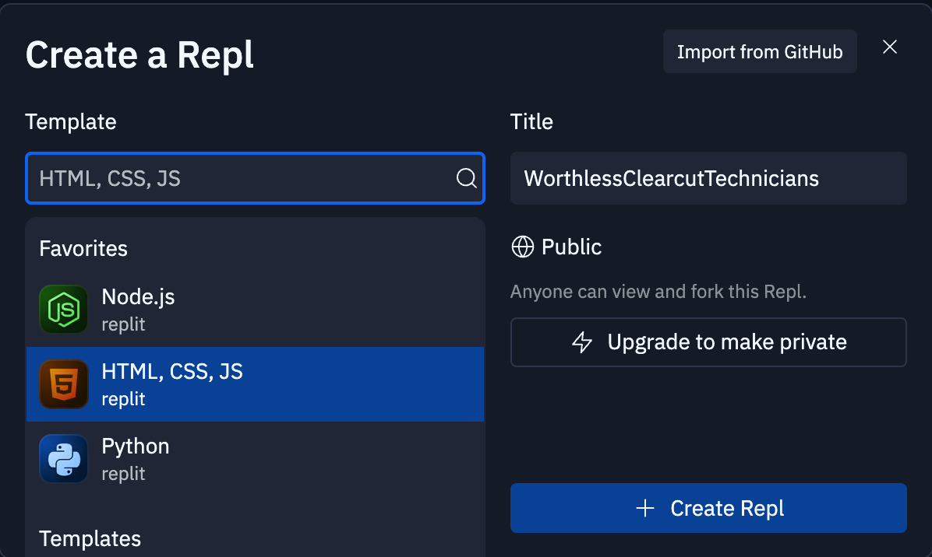
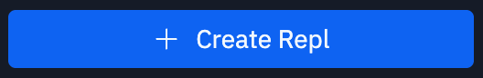
Creating a New Project
Click on Create Repl from top left corner
2. Select the Template as "HTML, CSS, JS"
3. Give your Project Name
4. Click on "+ Create Repl"
Notes:
Instructions for the Teacher:
Guide students through the process of creating an account on Replit.
Demonstrate how to access the HTML and CSS editor on Replit.
Class Activity:
Have students follow along as you create an account on Replit.
Encourage them to explore the features of Replit and familiarize themselves with the HTML and CSS editor.

Slide 13

Creating a Simple Webpage
Imagine a human body. Before you can see the outer appearance, you need a strong framework to hold everything together, right? That's what HTML does for webpages. It provides the basic structure and layout, like the skeleton of a human body.
Notes:
Instructions for the Teacher:
Introduce the concept of building a webpage using HTML.
Emphasize the importance of starting with a strong HTML framework before adding CSS styles.
Class Activity:
Guide students through the process of creating a simple webpage using HTML.
Provide step-by-step instructions and encourage students to follow along.

Slide 14
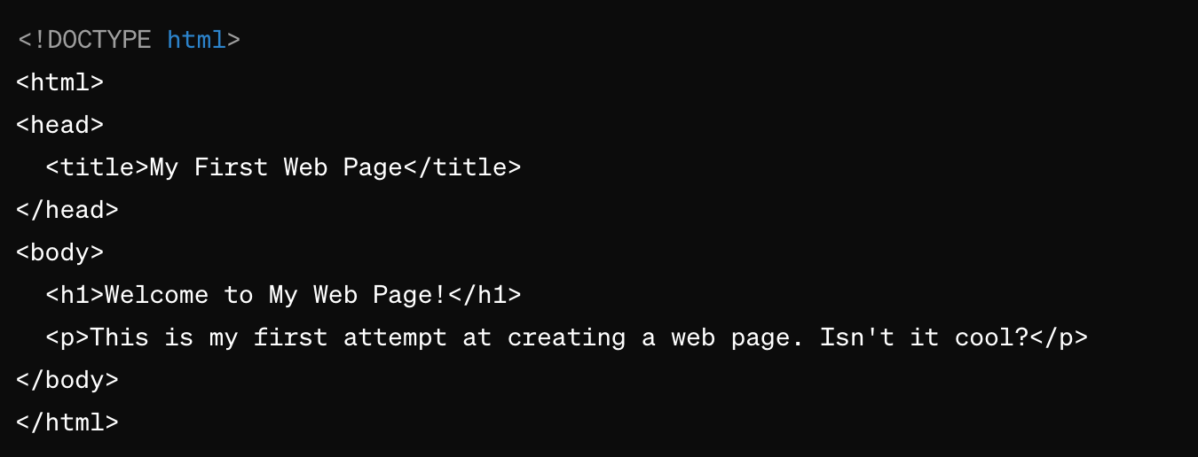
Let's Do It!
Okay, let's jump right in and build our first web page together!
Open up a text editor (REPLIT) on your computer, and let's start to become the future web gods.
Notes:
Link for the project: https://replit.com/@curriculumsmana/Project-Class-1-Grade-5and6#index.html
Instructions for the Teacher:
Encourage students to open a text editor (such as REPLIT) on their computers.
Emphasize the importance of hands-on practice in learning HTML.
Offer assistance to students as they begin to create their first web page.
Class Activity:
Guide students through the process of opening a text editor and starting a new HTML document.
Demonstrate how to write basic HTML code for a simple webpage.
Encourage students to experiment with different HTML elements and attributes.

Slide 15
This language seems like Gibberish
<!DOCTYPE html>: This tells the computer what version of HTML we're using, like a label on a recipe saying what kind of dish we're making.
<html>: This is the main container for all the content on the webpage, like the mixing bowl for all the ingredients.
<head>: This part holds important information about the webpage, like the title (name) of the page.
Notes:
"Teacher's Activity"
Instructions for the Teacher:
Explain the basic structure of an HTML document using the provided code snippets.
Use analogies to help students understand the purpose of each HTML element.
Class Activity:
Break down the code snippets and ask students to identify the purpose of each element.
Encourage them to compare HTML elements to components of a recipe or a book to reinforce understanding.

Slide 16
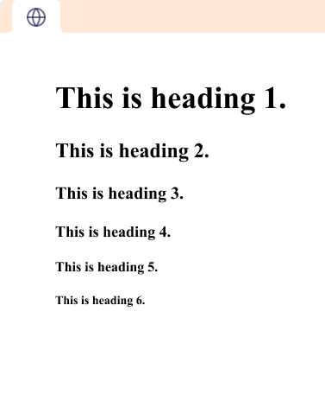
Headings of HTML
There are six different types of heading in html.
<h1>: The most important heading. Use it for main titles or sections.
<h2>: Slightly less important than <h1>. Good for subheadings.
<h3>, <h4>, <h5>: Decreasing levels of importance. Use them for subsections or details.
<h6>: Often used for fine print or footnotes.
Notes:
"Teacher's Activity"
Instructions for the Teacher:
Continue explaining HTML elements and their roles in a webpage.
Use analogies to make complex concepts more relatable to students.
Class Activity:
Show examples of HTML code and ask students to identify the purpose of each element.
Encourage them to create their own analogies to describe HTML elements.

Slide 17
This language seems like Gibberish
<title>: This is the name of the webpage that appears at the top of the browser tab, just like the title of a book.
<body>: This is where all the visible content of the webpage goes, like the main dish on a plate.
<h1>: This is a big heading, like the title of a chapter in a book.
<p>: This is a paragraph of text, like a small section in a book.
Notes:
"Teacher's Activity"
Instructions for the Teacher:
Continue explaining HTML elements and their roles in a webpage.
Use analogies to make complex concepts more relatable to students.
Class Activity:
Show examples of HTML code and ask students to identify the purpose of each element.
Encourage them to create their own analogies to describe HTML elements.

Slide 18

It's your turn to Shape it
We have learnt the basic spell of HTML – it’s
your time to do the magic.
Create something of your choice
It could be the details of your favorite food. Mmmm... Seems Yummy
Or your pet friend.
Let's see what you got in your big brain.
Notes:
"Student's Activity"
Instructions for the Teacher:
Challenge students to apply their knowledge of HTML by creating their own webpage.
Provide suggestions for topics they can choose to create their webpage about.
Class Activity:
Give students time to work on their webpage projects.
Encourage creativity and offer assistance as needed.

Slide 19

How to Save & Share the project.
Replit offers autosave option- so not worry about the same.
To share project with someone in view mode: just copy the link from the URL bar, and share the link
To share the project for collaboration
Click on "Invite" from the top right corner
If you know the username, type it in the box and click on invite
You can also turn on the toggle button "private join link" to create a public collaboration link and invite members to edit your code.
Notes:
Instructions for the Teacher:
Explain how to save and share projects on Replit, including the options for collaboration.
Emphasize the importance of sharing projects for feedback and collaboration.
Class Activity:
Have students save their webpage projects on Replit.
Encourage them to share their projects with classmates for feedback and collaboration.

Slide 20

Hey there! It's Quiz Time
Question 1: Which HTML element is used to define the structure of an HTML document?
A) <body>
B) <head>
C) <html>
D) <title>
Notes:
Instructions for the Teacher:
Conduct a quiz to assess students' understanding of the concepts covered in the presentation.
Allow students to answer each question individually before revealing the correct answer.
Use the quiz as an opportunity to reinforce key concepts and address any misconceptions.
Class Activity:
Present each quiz question to the class and allow students time to think about their answers.
Encourage students to discuss their answers with their peers before revealing the correct answer.
Provide explanations for each correct answer to ensure understanding.

Slide 21
Hey there! It's Quiz Time
Question 2: Which tag is used to define the body of an HTML document?
A) <head>
B) <title>
C) <body>
D) <html>
Notes:
Instructions for the Teacher:
Conduct a quiz to assess students' understanding of the concepts covered in the presentation.
Allow students to answer each question individually before revealing the correct answer.
Use the quiz as an opportunity to reinforce key concepts and address any misconceptions.
Class Activity:
Present each quiz question to the class and allow students time to think about their answers.
Encourage students to discuss their answers with their peers before revealing the correct answer.
Provide explanations for each correct answer to ensure understanding.

Slide 22
Hey there! It's Quiz Time
Question 3: What is the purpose of the <title> tag in an HTML document?
A) To define the title of the webpage
B) To insert a title image
C) To create a hyperlink
D) To format text
Notes:
Instructions for the Teacher:
Conduct a quiz to assess students' understanding of the concepts covered in the presentation.
Allow students to answer each question individually before revealing the correct answer.
Use the quiz as an opportunity to reinforce key concepts and address any misconceptions.
Class Activity:
Present each quiz question to the class and allow students time to think about their answers.
Encourage students to discuss their answers with their peers before revealing the correct answer.
Provide explanations for each correct answer to ensure understanding.

Slide 23
Hey there! It's Quiz Time
Question 4: Which of the following elements is typically found within the <head> section of an HTML document?
A) <body>
B) <title>
C) <footer>
D) <h1>
Notes:
Instructions for the Teacher:
Conduct a quiz to assess students' understanding of the concepts covered in the presentation.
Allow students to answer each question individually before revealing the correct answer.
Use the quiz as an opportunity to reinforce key concepts and address any misconceptions.
Class Activity:
Present each quiz question to the class and allow students time to think about their answers.
Encourage students to discuss their answers with their peers before revealing the correct answer.
Provide explanations for each correct answer to ensure understanding.

Slide 24
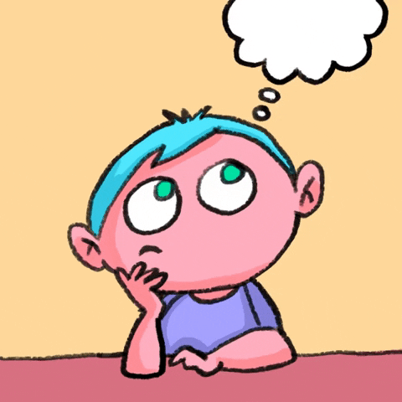
Let's Wrap it Up – What have we learnt? Today, we learned the basics of HTML and created our own web pages. Remember to keep practicing and exploring, and soon you'll be able to create even more amazing things with HTML!
Notes:
Instructions for the Teacher:
Summarize the key points covered in the presentation.
Reinforce the importance of practice and exploration in learning HTML.
Encourage students to continue learning and experimenting with HTML on their own.
Class Activity:
Invite students to share their thoughts and reflections on what they have learned.
Encourage them to ask any remaining questions they may have about HTML.
Remind students of additional resources they can use to further their understanding of HTML.

Slide 25

Homework Discussion
Notes:
Instructions for the Teacher:
Facilitate a discussion about the homework assignment.

Slide 26

Extra Marks for Extra Brain
Let's get creative and tell a story using HTML!
Create a short story about the most adventurous moment of your life. It could be anything from going on a trip,
Trekking, Scuba Diving or similar activity you would have tried.
Running from a scary dog could be considered one 😁

Slide 27
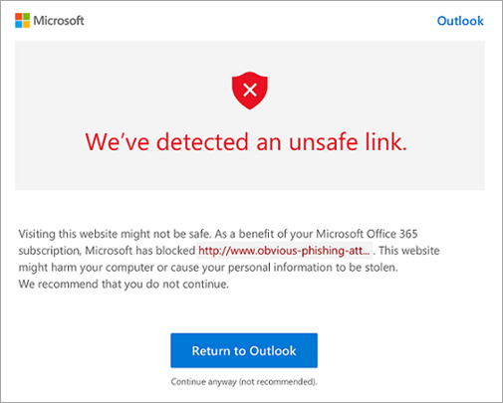
Think Before You Click
Verify sources before clicking on links. Don’t click on links/download files from unknown sources
Timmy received an email promising free video games if he clicked a mysterious link.
Without thinking, he clicked the link and his computer got a virus, causing lots of issues and losing all his files.
The moral of the story: always verify sources before clicking links to avoid harmful consequences.

